Slide 1
Which DNA Patterns Play the Role of Molecular Clocks?
Representers : keivan abbasi , shayan naji

Slide 2
Do we Have a "Clock" Gene?
The daily schedules of animals, plants, and even bacteria are controlled by an internal timekeeper called the circadian clock. Anyone who has experienced the misery of jet lag knows that this clock never stops ticking. Rats and research volunteers alike, when placed in a bunker, naturally maintain a roughly 24-hour cycle of activity and rest in total darkness. And, like any timepiece, the circadian clock can malfunction, resulting in a genetic disease known as delayed sleep-phase syndrome (DSPS).

Slide 3
Do we Have a "Clock" Gene?
The circadian clock must have some basis on the molecular level, which presents many questions. How do individual cells in animals and plants, let alone bacteria, know when they should slow down or increase the production of certain proteins? Is there a “clock gene”? Can we explain why heart attacks occur more often in the morning, while asthma attacks are more common at night? And can we identify genes that are responsible for “breaking” the circadian clock to cause DSPS?

Slide 4
Do we Have a "Clock" Gene?
In the early 1970s, Ron Konopka and Seymour Benzer identified mutant flies with abnormal circadian patterns and traced the flies’ mutations to a single gene. Biologists needed two more decades to discover a similar clock gene in mammals, which was just the first piece of the puzzle. Today, many more circadian genes have been discovered; these genes, having names like timeless, clock, and cycle, orchestrate the behavior of hundreds of other genes and display a high degree of evolutionary conservation across species.

Slide 5
Do we Have a "Clock" Gene?
We will first focus on plants, since maintaining the circadian clock in plants is a matter of life and death. Consider how many plant genes should pay attention to the time when the sun rises and sets; indeed, biologists estimate that over a thousand plant genes are circadian, including the genes related to photosynthesis, photo reception, and flowering. These genes must somehow know what time it is in order to change their gene transcript production, or gene expression, throughout the day.

Slide 6
Do we Have a "Clock" Gene?
It turns out that every plant cell keeps track of day and night independently of other cells, and that just three plant genes, called LHY, CCA1, and TOC1, are the clock’s master timekeepers. Such regulatory genes, and the regulatory proteins that they encode, are often controlled by external factors (e.g., nutrient availability or sunlight) in order to allow organisms to adjust their gene expression.

Slide 7
Do we Have a "Clock" Gene?
For example, regulatory proteins controlling the circadian clock in plants coordinate circadian activity as follows. TOC1 promotes the expression of LHY and CCA1, whereas LHY and CCA1 repress the expression of TOC1, resulting in a negative feedback loop. In the morning, sunlight activates the transcription of LHY and CCA1, triggering the repression of TOC1 transcription. As light diminishes, so does the production of LHY and CCA1, which in turn do not repress TOC1 any more. Transcription of TOC1 peaks at night and starts promoting the transcription of LHY and CCA1, which in turn repress the transcription of TOC1, and the cycle begins again.

Slide 8
Do we Have a "Clock" Gene?
LHY, CCA1, and TOC1 are able to control the transcription of other genes because the regulatory proteins that they encode are transcription factors, or master regulatory proteins that turn other genes on and off. A transcription factor regulates a gene by binding to a specific short DNA interval called a regulatory motif, or transcription factor binding site, in the gene's upstream region, a 600-1000 nucleotide-long region preceding the start of the gene. For example, CCA1 binds to AAAAAATCT in the upstream region of many genes regulated by CCA1.

Slide 9
Do we Have a "Clock" Gene?
The life of a bioinformatician would be easy if regulatory motifs were completely conserved, but the reality is more complex, as regulatory motifs may vary at some positions, e.g., CCA1 may instead bind to AAGAACTCT. But how can we locate these regulatory motifs without knowing what they look like in advance? We need to develop algorithms for motif finding, the problem of discovering a “hidden message” shared by a collection of strings.

Slide 10
Motif finding is more difficult than you think
Identifying the evening element
In 2000, Steve Kay used DNA arrays to determine which genes in the plant Arabidopsis thaliana are activated at different times of the day. He then extracted the upstream regions of nearly 500 genes that exhibited circadian behavior and looked for frequently appearing patterns in their upstream regions. If you concatenated these upstream regions into a single string, you would find that AAAATATCT is a surprisingly frequent word, appearing 46 times.

Slide 11
Identifying the evening element
STOP and Think: What is the possible downside of concatenating all the upstream regions into a single string and looking for frequent words in order to identify a motif?
Exercise Break: What is the expected number of occurrences of a 9-mer in 500 random DNA strings, each of length 1000? Assume that the sequences are formed by selecting each nucleotide (A, C, G, T) with the same probability (0.25).
Kay named AAAATATCT the evening element and performed a simple experiment to prove that it is indeed the regulatory motif responsible for circadian gene expression in Arabidopsis thaliana. After he mutated the evening element in the upstream region of one gene, the gene lost its circadian behavior.

Slide 12
Identifying the evening element
Whereas the evening element in plants is very conserved, and thus easy to find, motifs having many mutations are more elusive. For example, if you infect a fly with a bacterium, the fly will switch on its immunity genes to fight the infection. Thus, some of the genes with elevated expression levels after the infection are likely to be immunity genes. Indeed, some of these genes have 12-mers similar to TCGGGGATTTCC in their upstream regions, the binding site of a transcription factor called NF-kB that activates various immunity genes in flies. However, NF-κB binding sites are nowhere near as conserved as the evening element. The figure below shows ten NF-κB binding sites from the Drosophila melanogaster genome; the most popular nucleotides in every column are shown by upper case colored letters.

Slide 13
1 T C G G G G g T T T t t
2 c C G G t G A c T T a C
3 a C G G G G A T T T t C
4 T t G G G G A c T T t t
5 a a G G G G A c T T C C
6 T t G G G G A c T T C C
7 T C G G G G A T T c a t
8 T C G G G G A T T c C t
9 T a G G G G A a c T a C
10 T C G G G t A T a a C C
Figure: The ten candidate NF-κB binding sites appearing in the Drosophila melanogaster genome. The colored upper case letters indicate the most frequent nucleotide in each column.

Slide 14
Hide and seek with motifs
Our aim is to turn the biological challenge of finding regulatory motifs into a computational problem. Below, we have implanted a 15-mer hidden message at a randomly selected position in each of ten randomly generated DNA strings. This example mimics a transcription factor binding site hiding in the upstream regions of ten genes.

Slide 15
Hide and seek with motifs
1 "atgaccgggatactgataaaaaaaagggggggggcgtacacattagataaacgtatgaagtacgttagactcggcgccgccg" 2 "acccctattttttgagcagatttagtgacctggaaaaaaaatttgagtacaaaacttttccgaataaaaaaaaaggggggga" 3 "tgagtatccctgggatgacttaaaaaaaagggggggtgctctcccgatttttgaatatgtaggatcattcgccagggtccga" 4 "gctgagaattggatgaaaaaaaagggggggtccacgcaatcgcgaaccaacgcggacccaaaggcaagaccgataaaggaga" 5 "tcccttttgcggtaatgtgccgggaggctggttacgtagggaagccctaacggacttaataaaaaaaagggggggcttatag" 6 "gtcaatcatgttcttgtgaatggatttaaaaaaaaggggggggaccgcttggcgcacccaaattcagtgtgggcgagcgcaa" 7 "cggttttggcccttgttagaggcccccgtaaaaaaaagggggggcaattatgagagagctaatctatcgcgtgcgtgttcat" 8 "aacttgagttaaaaaaaagggggggctggggcacatacaagaggagtcttccttatcagttaatgctgtatgacactatgta" 9 "ttggcccattggctaaaagcccaacttgacaaatggaagatagaatccttgcataaaaaaaagggggggaccgaaagggaag" 10"ctggtgagcaacgacagattcttacgtgcattagctcgcttccggggatctaatagcacgaagcttaaaaaaaaggggggga"

Slide 16
Hide and seek with motifs
STOP and Think: Can you find the implanted hidden message?
This is a simple problem – applying an algorithm for the Frequent Words Problem to the concatenation of these strings will immediately reveal the most frequent 15-mer shown below as the implanted pattern. Since these short strings were randomly generated, it is unlikely that they contain other frequent 15-mers.

Slide 17
Hide and seek with motifs
1 "atgaccgggatactgatAAAAAAAAGGGGGGGggcgtacacattagataaacgtatgaagtacgttagactcggcgccgccg" 2 "acccctattttttgagcagatttagtgacctggaaaaaaaatttgagtacaaaacttttccgaataAAAAAAAAGGGGGGGa" 3 "tgagtatccctgggatgacttAAAAAAAAGGGGGGGtgctctcccgatttttgaatatgtaggatcattcgccagggtccga" 4 "gctgagaattggatgAAAAAAAAGGGGGGGtccacgcaatcgcgaaccaacgcggacccaaaggcaagaccgataaaggaga" 5 "tcccttttgcggtaatgtgccgggaggctggttacgtagggaagccctaacggacttaatAAAAAAAAGGGGGGGcttatag" 6 "gtcaatcatgttcttgtgaatggatttAAAAAAAAGGGGGGGgaccgcttggcgcacccaaattcagtgtgggcgagcgcaa" 7 "cggttttggcccttgttagaggcccccgtAAAAAAAAGGGGGGGcaattatgagagagctaatctatcgcgtgcgtgttcat" 8 "aacttgagttAAAAAAAAGGGGGGGctggggcacatacaagaggagtcttccttatcagttaatgctgtatgacactatgta" 9 "ttggcccattggctaaaagcccaacttgacaaatggaagatagaatccttgcatAAAAAAAAGGGGGGGaccgaaagggaag" 10"ctggtgagcaacgacagattcttacgtgcattagctcgcttccggggatctaatagcacgaagcttAAAAAAAAGGGGGGGa"

Slide 18
Hide and seek with motifs
Now imagine that instead of implanting exactly the same pattern into all sequences, we mutate the pattern before inserting it into each sequence by randomly changing the nucleotides at four randomly selected positions within each implanted 15-mer, as shown below.

Slide 19
Hide and seek with motifs
1 "atgaccgggatactgatAgAAgAAAGGttGGGggcgtacacattagataaacgtatgaagtacgttagactcggcgccgccg" 2 "acccctattttttgagcagatttagtgacctggaaaaaaaatttgagtacaaaacttttccgaatacAAtAAAAcGGcGGGa" 3 "tgagtatccctgggatgacttAAAAtAAtGGaGtGGtgctctcccgatttttgaatatgtaggatcattcgccagggtccga" 4 "gctgagaattggatgcAAAAAAAGGGattGtccacgcaatcgcgaaccaacgcggacccaaaggcaagaccgataaaggaga" 5 "tcccttttgcggtaatgtgccgggaggctggttacgtagggaagccctaacggacttaatAtAAtAAAGGaaGGGcttatag" 6 "gtcaatcatgttcttgtgaatggatttAAcAAtAAGGGctGGgaccgcttggcgcacccaaattcagtgtgggcgagcgcaa" 7 "cggttttggcccttgttagaggcccccgtAtAAAcAAGGaGGGccaattatgagagagctaatctatcgcgtgcgtgttcat" 8 "aacttgagttAAAAAAtAGGGaGccctggggcacatacaagaggagtcttccttatcagttaatgctgtatgacactatgta" 9 "ttggcccattggctaaaagcccaacttgacaaatggaagatagaatccttgcatActAAAAAGGaGcGGaccgaaagggaag" 10"ctggtgagcaacgacagattcttacgtgcattagctcgcttccggggatctaatagcacgaagcttActAAAAAGGaGcGGa"

Slide 20
Hide and seek with motifs
Applying our solution to the Frequent Words Problem is no longer going to help us, since AAAAAAAAGGGGGGG does not even appear in the sequences above. Perhaps, then, we could apply our solution to the Frequent Words with Mismatches Problem. However, in Chapter 1, we implemented an algorithm for the Frequent Words with Mismatches Problem aimed at finding hidden messages with a small number of mismatches and a small k-mer size (e.g., one or two mismatches for DnaA boxes of length 9). This algorithm is likely to become too slow when searching for the implanted motif above, which is longer and has more mutations.

Slide 21
Hide and seek with motifs
Furthermore, the Frequent Words Problem is inadequate because it does not correctly model the biological problem of motif finding. A DnaA box is a pattern that clumps, or appears frequently, within a relatively short interval of the genome. In contrast, a regulatory motif is a pattern that appears at least once (perhaps with variation) in each of many different regions that are scattered throughout the genome.

Slide 22
A brute force algorithm for motif finding
Given a collection of strings Dna and an integer d, a k-mer is a (k,d)-motif if it appears in every string from Dna with at most d mismatches. For example, the implanted 15-mer in the strings above represents a (15,4)-motif.
Implanted Motif Problem: Find all (k, d)-motifs in a collection of strings.
Input: A collection of strings Dna, and integers k and d.
Output: All (k, d)-motifs in Dna.
Brute force (also known as exhaustive search) is a general problem-solving technique that explores all possible solution candidates and checks whether each candidate solves the problem. Such algorithms require little effort to design and are guaranteed to produce a correct solution, but they may take an enormous amount of time, and the number of candidates may be too large to check.

Slide 23
A brute force algorithm for motif finding
A brute force approach for solving the Implanted Motif Problem is based on the observation that any (k, d)-motif must be at most d mismatches apart from some k-mer appearing in the first string in Dna. Therefore, we can generate all such k-mers and then check which of them are (k, d)-motifs.
MotifEnumeration(Dna, k, d)
Patterns ← an empty set
for each k-mer Pattern in the first string in Dna
for each k-mer Pattern’ differing from Pattern by at most d mismatches
if Pattern' appears in each string from Dna with at most d mismatches
add Pattern' to Patterns
remove duplicates from Patterns
return Patterns

Slide 24
A brute force algorithm for motif finding
STOP and Think: Estimate the running time of MotifEnumeration.
MotifEnumeration is unfortunately rather slow for large values of k and d, and so we will try a different approach instead. Maybe we can detect an implanted pattern simply by identifying the two most similar k-mers between each pair of strings in Dna? However, consider the implanted 15-mers AgAAgAAAGGttGGG and cAAtAAAAcGGGGcG, each of which differs from AAAAAAAAGGGGGGG by four mismatches. Although these 15-mers look similar to the correct motif AAAAAAAAGGGGGGG, they are not so similar when compared to each other, having eight mismatches:

Slide 25
A brute force algorithm for motif finding
AgAAgAAAGGttGGG
|| || | || |
cAAtAAAAcGGGGcG
Since these two implanted patterns are so different, we should be concerned whether we will be able to find them by searching for the two similar k-mers among pairs of strings in Dna.

Slide 26
Scoring Motifs
From motifs to profile matrices and consensus strings
Although the Implanted Motif Problem offers a useful abstraction of the biological problem of motif finding, it has some limitations. For example, when Steve Kay used a DNA array to infer the set of circadian genes in plants, he did not expect that all genes in the resulting set would have the evening element (or its variants) in their upstream regions. Similarly, biologists do not expect that all genes with an elevated expression level in infected flies must be regulated by NF-κB. DNA array experiments are inherently noisy, and some genes identified by these experiments have nothing to do with the circadian clock in plants or immunity genes in flies. For such noisy datasets, any algorithm for the Implanted Motif Problem would fail, because as long as a single sequence does not contain the transcription factor binding site, a (k, d)-motif does not exist!

Slide 27
From motifs to profile matrices and consensus strings
A more appropriate problem formulation would score individual instances of motifs depending on how similar they are to an “ideal” motif (i.e., a transcription factor binding site that binds the best to the transcription factor). However, since the ideal motif is unknown, we attempt to select a k-mer from each string and score these k-mers depending on how similar they are to each other.

Slide 28
From motifs to profile matrices and consensus strings
To define scoring, consider a list of t DNA strings Dna, where each string has length n, and select a k-mer from each string to form a collection Motifs, which we represent as a t x k motif matrix. In the figure below, which shows the motif matrix for the NF-κB binding sites from the figure below, we indicate the most frequent nucleotide in each column of the motif matrix by upper case letters. If there are multiple most frequent nucleotides in a column, then we arbitrarily select one of them to break the tie. Note that positions 2 and 3 are the most conserved (nucleotide G is completely conserved in these positions), whereas position 10 is the least conserved.

Slide 29
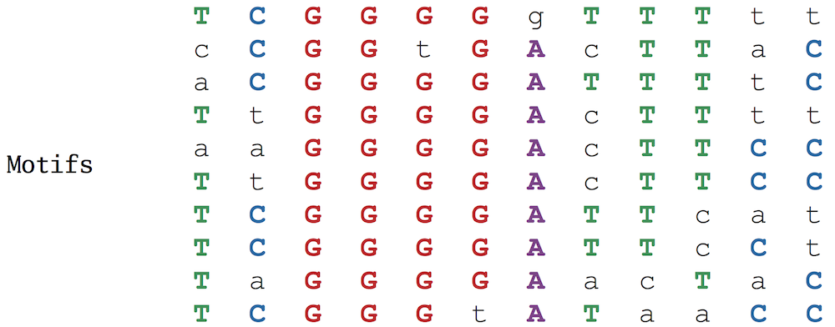
Figure: The NF-κB binding sites form a 10 x 12 motif matrix, with the most frequent nucleotide in each column shown in upper case letters and all other nucleotides shown in lower case letters.

Slide 30
From motifs to profile matrices and consensus strings
By varying the choice of k-mers in each sequence, we can construct a large number of different motif matrices from a given sample of DNA sequences. Our goal is to select k-mers resulting in the most “conserved” motif matrix, meaning the matrix with the most upper case letters (and thus the fewest number of lower case letters). Leaving aside the question of how we select such k-mers, we will first focus on how to score the resulting motif matrices, defining Score(Motifs) as the number of unpopular (lower case) letters in the motif matrix Motifs. Our goal is to find a collection of k-mers that minimizes this score.

Slide 31
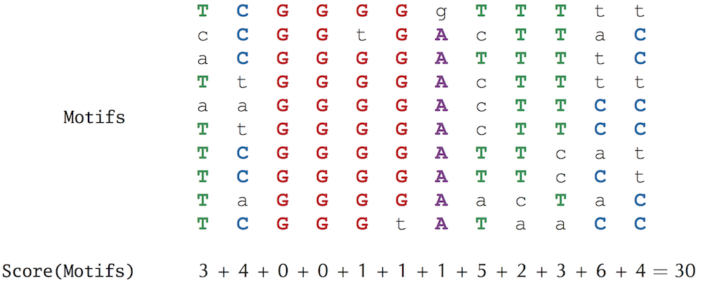
Exercise Break: The minimium possible value of Score(Motifs) is 0 (if all the k-mers in Motifs are the same). What is the maximum possible value of Score(Motifs) for 10 motifs of length 15?

Slide 32
From motifs to profile matrices and consensus strings
We can construct the 4 × k count matrix Count(Motifs) counting the number of occurrences of each nucleotide in each column of the motif matrix; the (i, j)-th element of Count(Motifs) stores the number of times that nucleotide i appears in column j of Motifs. We will further divide all of the elements in the count matrix by t, the number of rows in Motifs. This results in a profile matrix P = Profile(Motifs) for which P_{i,j} is the frequency of the i-th nucleotide in the j-th column of the motif matrix. Note that the elements of any column of the profile matrix sum to 1. The figure below shows the motif, count, and profile matrices for the NF-κB binding sites.

Slide 33
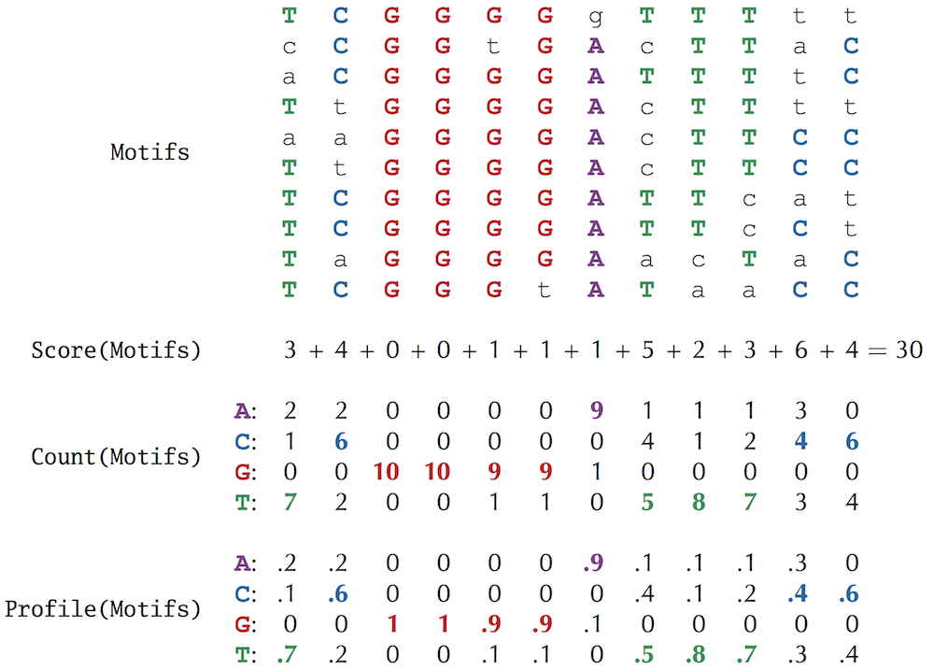
Finally, we form a consensus string, denoted Consensus(Motifs), from the most popular letters in each column of the motif matrix. If we select Motifs correctly from the collection of upstream regions, then Consensus(Motifs) provides an ideal candidate regulatory motif for these regions. For example, the consensus string for the NF-κB binding sites in the figure below is TCGGGGATTTCC.

Slide 34
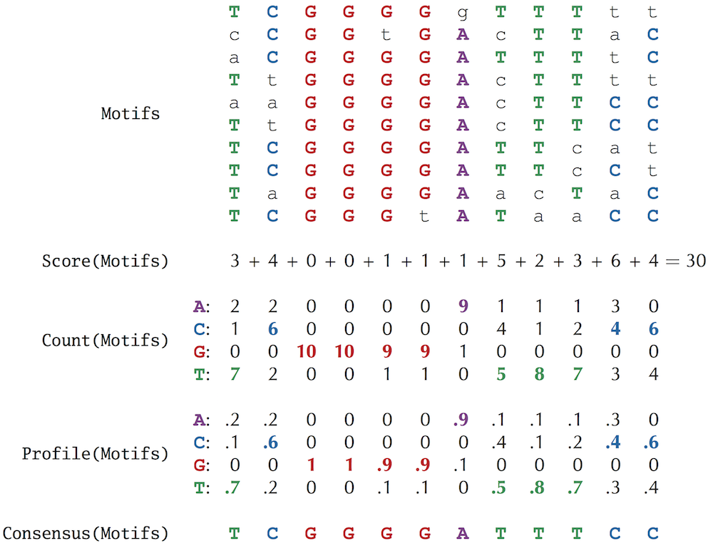

Slide 35
Towards a more adequate motif scoring function
Consider the second column (containing 6 C, 2 A, and 2 T) and the final column (containing 6 C and 4 T) in the motif matrix reproduced below. Both of these columns contribute 4 to Score(Motifs).
STOP and Think: Does scoring these two columns equally make sense biologically?

Slide 36
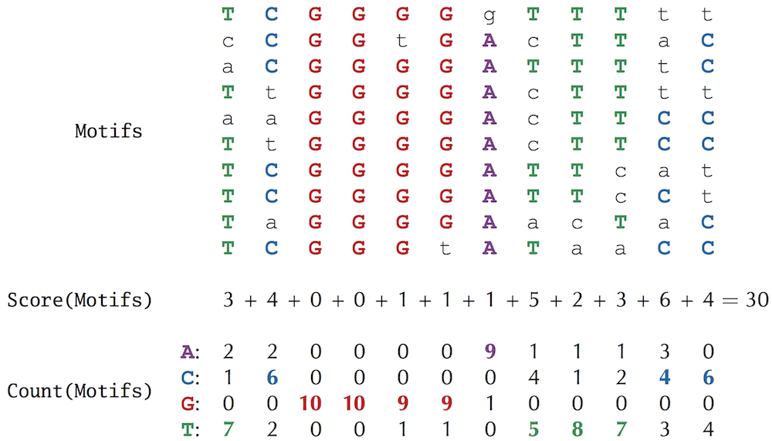

Slide 37
Towards a more adequate motif scoring function
For many biological motifs, certain positions feature two nucleotides with roughly the same ability to bind to a transcription factor. For example, the sixteen nucleotide-long CSRE transcription factor binding site in the yeast species S. cerevisiae consists of five strongly conserved positions (1, 8, 9, 12, and 13) in addition to eleven weakly conserved positions, each of which features two nucleotides with similar frequencies

Slide 38
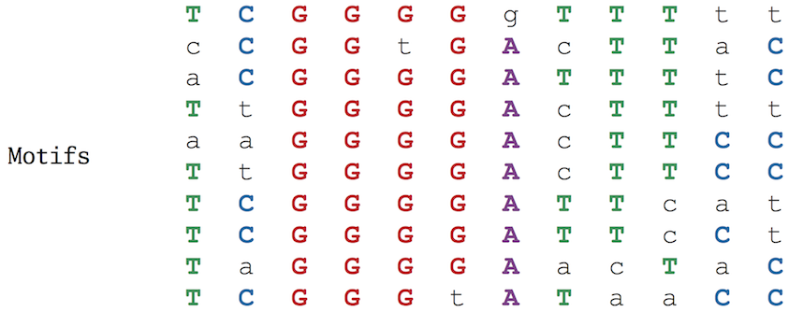
Towards a more adequate motif scoring function
Following this example, a more appropriate representation of the consensus string TCGGGGATTTCC for the NF-κB binding sites should include viable alternatives to the most popular nucleotides in each column. For example, nucleotides with frequencies equal to or exceeding 0.4. In this sense, the last column (6 C, 4 T) in the NF-κB motif matrix (reproduced below) is “more conserved” than the 2nd column (6 C, 2 A, 2 T) and should receive a lower score.

Slide 39
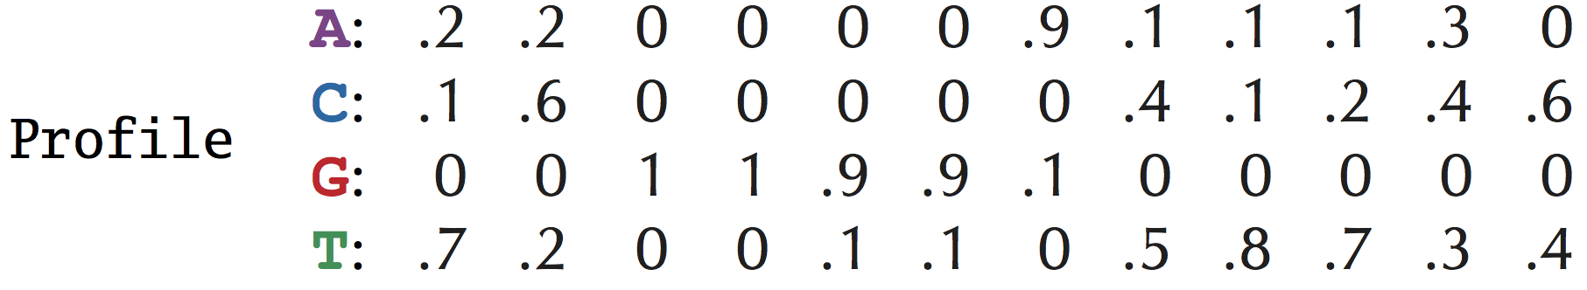
Entropy and the motif logo
Every column of Profile(Motifs) corresponds to a probability distribution, or a collection of nonnegative numbers that sum to 1. For example, the 2nd column in the profile matrix for the NF-κB binding sites corresponds to the probabilities 0.2, 0.6, 0.0, and 0.2 for A, C, G, and T, respectively.

Slide 40
Entropy and the motif logo
Entropy is a measure of the uncertainty of a probability distribution (p₁, …, p_{N}), and is defined as follows:
H(p₁, ... p_{N}) = -Σ_{i=1}^{N} p_{i} · log₂ p_{i}
For example, the entropy of the probability distribution (0.2, 0.6, 0.0, 0.2) corresponding to the 2nd column of the NF-κB profile matrix is
-(0.2 log₂ (0.2) + 0.6 log₂ (0.6) + 0.0 log₂ (0.0) + 0.2 log₂ (0.2) ≈ 1.371
whereas the entropy of the more conserved final column (0.0, 0.6, 0.0, 0.4) is
-(0.0 log₂ (0.0) + 0.6 log₂ (0.6) + 0.0 log₂ (0.0) + 0.4 log₂ (0.4)) ≈ 0.971
and the entropy of the very conserved 5th column (0.0, 0.0, 0.9, 0.1) is
-(0.0 log₂ (0.0) + 0.0 log₂ (0.0) + 0.9 log₂ (0.9) + 0.1 log₂ (0.1) ) ≈ 0.467
Note: Technically, log₂(0) is undefined, but in the computation of entropy, we assume that 0 · log₂(0) is equal to 0.

Slide 41
Entropy and the motif logo
STOP and Think: What are the maximum and minimum possible values for the entropy of a probability distribution containing four values?
The entropy of the completely conserved third column is 0, which is the minimum possible entropy. On the other hand, a column with equally-likely nucleotides (all probabilities equal to 1/4) has maximum possible entropy −4 · 1/4 · log₂(1/4) = 2. In general, the more conserved the column, the smaller its entropy. Thus, entropy offers an improved method of scoring motif matrices: the entropy of a motif matrix is defined as the sum of the entropies of its columns. In this book, we will continue to use Score(Motifs) for simplicity, but the entropy score is used more often in practice.

Slide 42
Exercise Break: Compute the entropy of the NF-κB motif matrix (reproduced below).

Slide 43
Entropy and the motif logo
Another application of entropy is the motif logo, a diagram for visualizing motif conservation that consists of a stack of letters at each position. We show a motif logo for the NF-κB motif matrix at the bottom. The relative sizes of letters indicate their frequency in the column. The total height of the letters in a column is based on the information content of the column, which is defined as 2 − H(p₁, … , p_{N}). The lower the entropy, the higher the information content, meaning that tall columns in the motif logo are highly conserved.

Slide 44
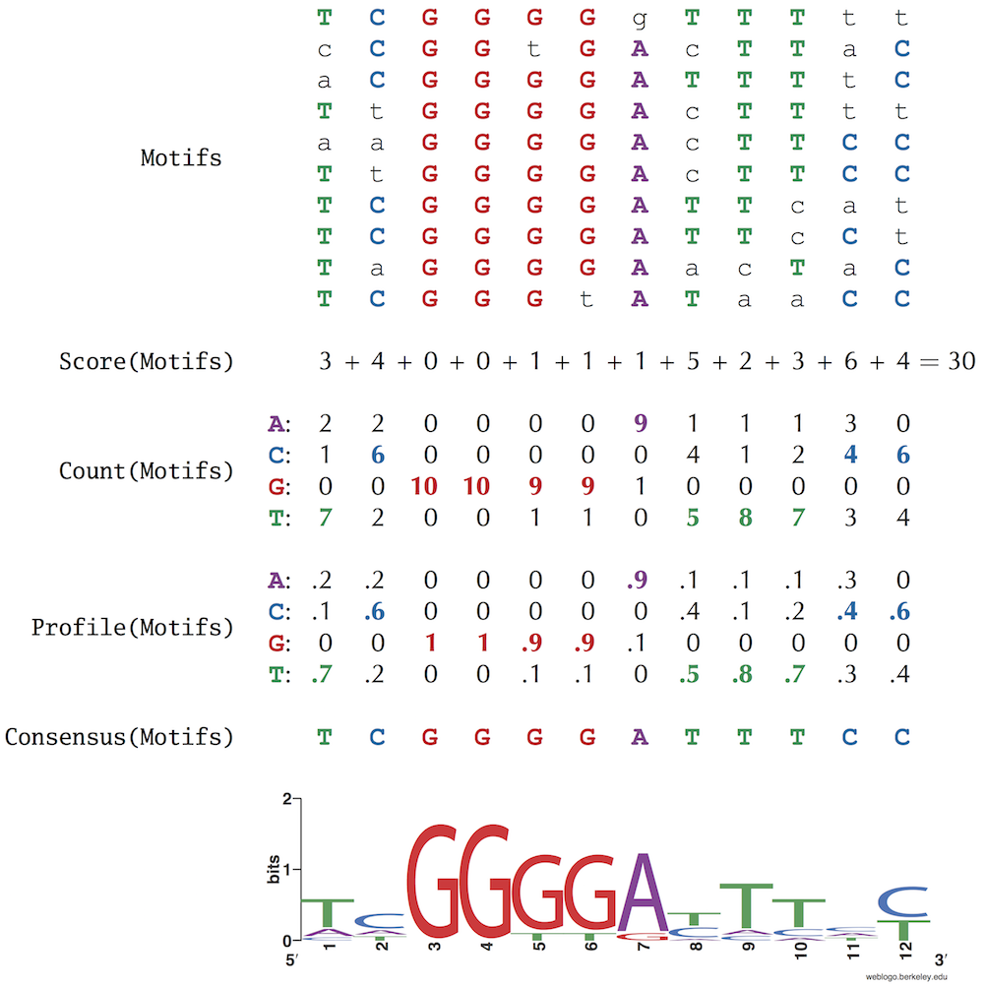

Slide 45
From Motif Finding to Finding a Median String
The Motif Finding Problem
Now that we have a good grasp of scoring a collection of k-mers, we are ready to formulate the Motif Finding Problem.
Motif Finding Problem: Given a collection of strings, find a set of k-mers, one from each string, that minimizes the score of the resulting motif.
Input: A collection of strings Dna and an integer k.
Output: A collection Motifs of k-mers, one from each string in Dna, minimizing Score(Motifs) among all possible choices of k-mers.

Slide 46
The Motif Finding Problem
A brute force algorithm for the Motif Finding Problem (referred to as BruteForceMotifSearch) considers every possible choice of k-mers Motifs from Dna (one k-mer from each string of n nucleotides) and returns the collection Motifs having minimum score. Because there are n - k + 1 choices of k-mers in each of t sequences, there are (n - k + 1)^{t} different ways to form Motifs. For each choice of Motifs, the algorithm calculates Score(Motifs), which requires k · t steps. Thus, assuming that k is smaller than n, the overall running time of the algorithm is O(n^{t} · k · t). We need to come up with a faster algorithm!

Slide 47
Reformulating the Motif Finding Problem
Because BruteForceMotifSearch is inefficient, we will think about motif finding in a different way. Instead of exploring all Motifs in Dna and deriving the consensus string from Motifs afterwards:
Motifs → Consensus(Motifs),
we will explore all potential k-mer consensus strings first and then find the best possible collection Motifs for each consensus string:
Consensus(Motifs) → Motifs.

Slide 48
Reformulating the Motif Finding Problem
To reformulate the motif finding problem, we need to devise an alternative way of computing Score(Motifs). Until now, we have computed Score(Motifs), the number of lower case letters in the motif matrix, column-by-column. For example, we previously computed the score of the NF-κB motif matrix as 3 + 4 + 0 + 0 + 1 + 1 + 1 + 5 + 2 + 3 + 6 + 4 = 30. The figure below illustrates that Score(Motifs) can just as easily be computed row-by-row (3 + 4 + 2 + 4 + 3 + 2 + 3 + 2 + 4 + 3 = 30). Note that each element in the latter sum represents the number of mismatches between the consensus string TCGGGGATTTCC and a motif in the corresponding row of the motif matrix, i.e., the Hamming distance between these strings. For the first row of the motif matrix below, d(TCGGGGATTTCC, TCGGGGgTTTtt) = 3.

Slide 49
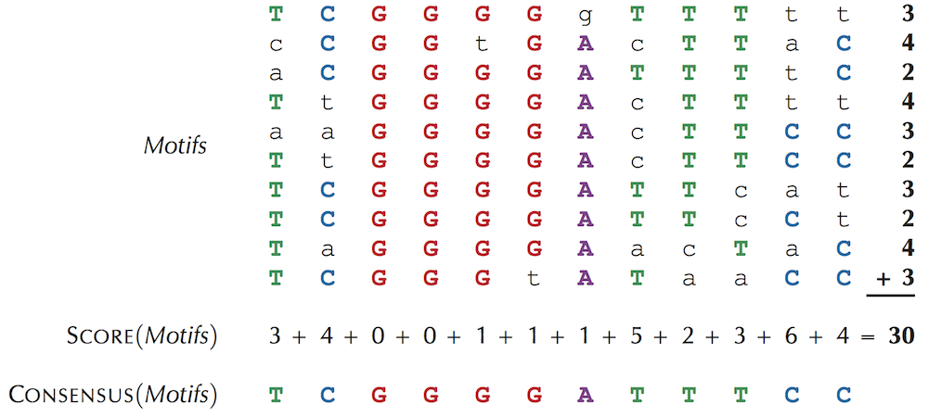
Figure: The motif and score matrices in addition to consensus string for the NF-κB binding sites. Rather than add the non-consensus elements (i.e., lower case nucleotides) column-by-column, we can add them row-by-row, as highlighted on the right of the motifs matrix. Each value at the end of a row corresponds to the Hamming distance between that row and the consensus string.

Slide 50
Reformulating the Motif Finding Problem
Given a collection of k-mers Motifs = {Motif₁, … , Motif_{t}} and a k-mer Pattern,we now define d(Pattern, Motifs) as the sum of Hamming distances between Pattern and each Motif_{i}:
d(Pattern, Motifs) = Σ_{i=1}^{t} HammingDistance(Pattern, Motif_{i}).

Slide 51
Reformulating the Motif Finding Problem
Because Score(Motifs) corresponds to counting the lower case elements of Motifs column-by-column and d(Consensus(Motifs), Motifs) corresponds to counting these elements row-by-row, we obtain that
Score(Motifs) = d(Consensus(Motifs), Motifs).
This equation gives us an idea. Instead of searching for a collection of k-mers Motifs minimizing
Score(Motifs)
let's instead search for a potential consensus string Pattern minimizing
d(Pattern, Motifs)

Slide 52
Reformulating the Motif Finding Problem
among all possible k-mers Pattern and all possible choices of k-mers Motifs in Dna. This problem is equivalent to the Motif Finding Problem.
Equivalent Motif Finding Problem: Given a collection of strings, find a collection of k-mers (one from each string) that minimizes the distance between all possible patterns and all possible collections of k-mers.
Input: A collection of strings Dna and an integer k.
Output: A k-mer Pattern and a collection of k-mers, one from each string in Dna, minimizing d(Pattern, Motifs) among all possible choices of Pattern and Motifs.

Slide 53
The Median String Problem
But wait a second — have we not just made our task more difficult? Instead of having to search for all Motifs, we now have to search all Motifs as well as all k-mers Pattern. The key observation for solving the Equivalent Motif Finding Problem is that, given Pattern, we don’t need to explore all possible collections Motifs in order to minimize d(Pattern, Motifs).
To explain how this can be done, we define Motifs(Pattern, Dna) as a collection of k-mers that minimizes d(Pattern, Motifs) for a given Pattern and all possible sets of k-mers Motifs in Dna. For example, for the strings Dna shown below, the five colored 3-mers represent Motifs(AAA, Dna)

Slide 54
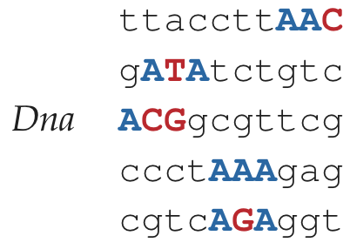
STOP and Think: Given a collection of strings Dna and a k-mer Pattern, design a fast algorithm for generating Motifs(Pattern, Dna).

Slide 55
The Median String Problem
he reason why we don’t need to consider all possible collections Motifs in Dna = Dna₁, ..., Dna_{t} is that we can generate the k-mers in Motifs(Pattern, Dna) one at a time; that is, we can select a k-mer in Dna_{i} independently of selecting k-mers in all other strings in Dna. Given a k-mer Pattern and a longer string Text, we use d(Pattern, Text) to denote the minimum Hamming distance between Pattern and any k-mer in Text,
d(Pattern, Text) = min_{all k-mers Pattern' in Text} HammingDistance(Pattern, Pattern')
For example,
d(GATTCTCA, GCAAAGACGCTGACCAA) = 3.

Slide 56
The Median String Problem
A k-mer in Text that achieves the minimum Hamming distance with Pattern is denoted Motif(Pattern, Text). For the above example,
Motif(GATTCTCA, GCAAAGACGCTGACCAA) = GACGCTGA.
We note that the notation Motif(Pattern, Text) is ambiguous because there may be multiple k-mers in Text that achieve the minimum Hamming distance with Pattern. For example, Motif(AAG, GCAATCCTCAGC) could be either AAT or CAG. If there are multiple k-mers in Text having minimum Hamming distance with Pattern, we select the first such k-mer in Text as Motif(Pattern, Text).
Given a k-mer Pattern and a set of strings Dna = {Dna₁, … , Dna_{t}}, we define d(Pattern, Dna) as the sum of distances between Pattern and all strings in Dna,
d(Pattern, Dna) = Σ_{i=1}^{t} d(Pattern, Dna _{i} ) .

Slide 57
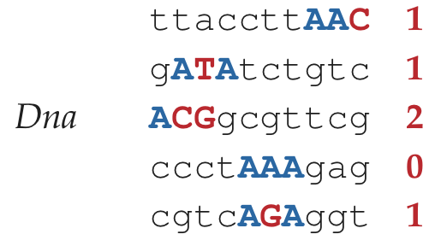
For example, for the strings Dna shown below, d(AAA, Dna) = 1 + 1 + 2 + 0 + 1 = 5.

Slide 58
The Median String Problem
Our goal is to find a k-mer Pattern that minimizes d(Pattern, Dna) over all k-mers Pattern, the same task that the Equivalent Motif Finding Problem is trying to achieve. We call such a k-mer a median string for Dna.
Median String Problem: Find a median string.
Input: A collection of strings Dna and an integer k.
Output: A k-mer Pattern that minimizes d(Pattern, Dna) among all possible choices of k-mers.
Notice that finding a median string requires solving a double minimization problem. We must find a k-mer Pattern that minimizes d(Pattern, Dna), where this function is itself computed by taking a minimum over all choices of k-mers from each string in Dna.

Slide 59
The Median String Problem
We now give the pseudocode for a brute force solution to the Median String Problem.
MedianString(Dna, k)
distance ← ∞
Median ← ""
for each k-mer Pattern from AA…AA to TT…TT
if distance > d(Pattern, Dna)
distance ← d(Pattern, Dna)
Median ← Pattern
return Median

Slide 60
Why have we reformulated the Motif Finding Problem?
To see why we reformulated the Motif Finding Problem as the equivalent Median String Problem, consider the runtime of MedianString and BruteForceMotifSearch. The former algorithm computes d(Pattern, Dna) for each of the 4^{k} k-mers Pattern. Each computation of d(Pattern, Dna) requires a single pass over each string in Dna, which requires approximately k · n · t operations for t strings of length n in Dna. Therefore, MedianString has a running time of O(4^{k} · n · k · t), which in practice compares favorably with the O(n^{t} · k · t) running time of BruteForceMotifSearch because the length of a motif (k) typically does not exceed 20 nucleotides, whereas t is measured in the thousands.

Slide 61
Why have we reformulated the Motif Finding Problem?
The Median String Problem teaches an important lesson, which is that sometimes rethinking how a problem is formulated can lead to dramatic improvements in the runtime required to solve it. In this case, our simple observation that Score(Motifs) could just as easily be computed row-by-row as column-by-column produced the faster MedianString algorithm.

Slide 62
Why have we reformulated the Motif Finding Problem?
Of course, the ultimate test of a bioinformatics algorithm is how it performs in practice. Unfortunately, since MedianString has to consider 4^{k} k-mers, it becomes too slow for the Subtle Motif Problem, for which k = 15. We will run MedianString with k = 13 in the hope that it will capture a substring of the correct 15-mer motif. The algorithm still requires half a day to run on our computer and returns the median string AAAAAtAGaGGGG (with distance 29). This 13-mer is not a substring of the implanted pattern AAAAAAAAGGGGGGG, but it does come close.

Slide 63
Why have we reformulated the Motif Finding Problem?
STOP and Think: How can a slightly incorrect median string of length 13 help us find the correct median string of length 15?
We have thus far assumed that the value of k is known in advance, which is not the case in practice. As a result, we are forced to run our motif finding algorithms for different values of k and then try to deduce the correct motif length. Since some regulatory motifs are rather long — later in the chapter, we will search for a biologically important motif of length 20 — MedianString may be too slow to find them.

Slide 64
Thx for listening hope you enjoyed

